Slide 1

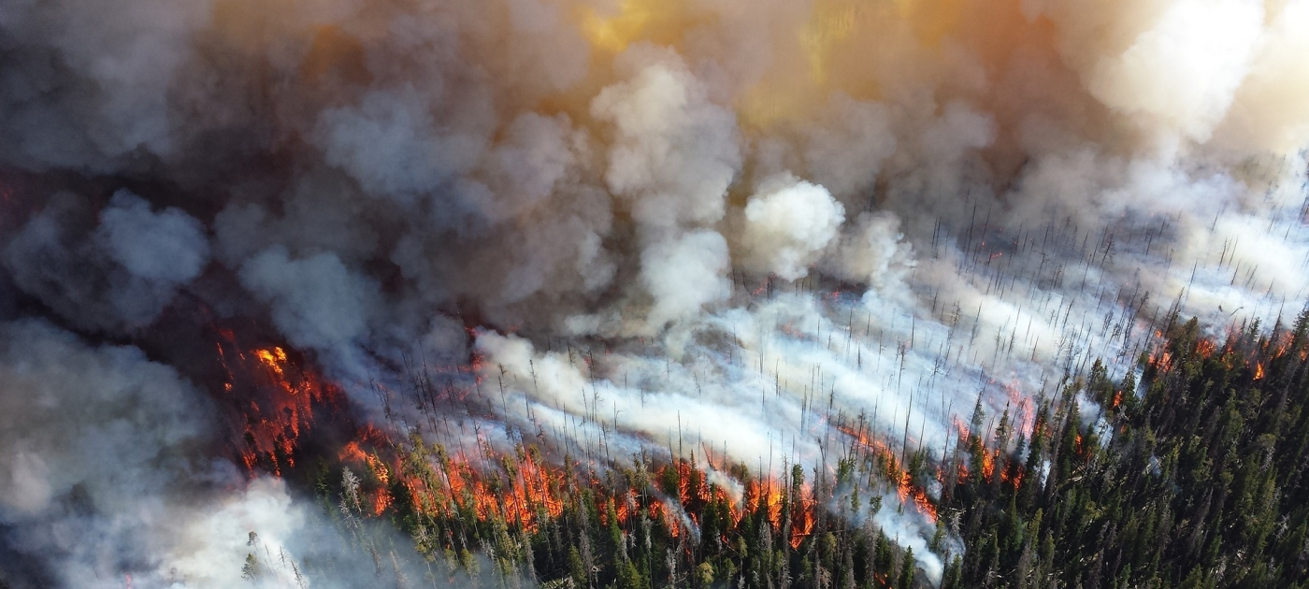
Fire Recognition System
COGORDAN Alexandre
BEN BACCAR Wael

Slide 2
INTRODUCTION
Presentation Schedule
Reasons
Sources
Analysis & Experiments
Results
Implementation
Cost
Improvements
Conclusion

Slide 3





INTRODUCTION
WHY?
More experience
More thrilling
Protect our planet
(flora and fauna)
Intuition and experience
Economy

Slide 4


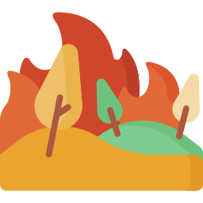
INTRODUCTION
Causes
Global warming
Longer, warmer summers
Governments
aren’t prepared
Longer, wider & more
vigorous wildfires
(we need to stop them early)

Slide 5






OUR SOURCES
6089 images
More versatile
Less bias

Slide 6
ANALYSIS
Model training
Neural Networks
CNN
MLP
Boosting Methods
Ada Boosting
Gradient Boosting
Random Forest
Decision Trees
Libraries
Numpy
Matplotlib
Sklearn
Tensorflow (Keras)

Slide 7
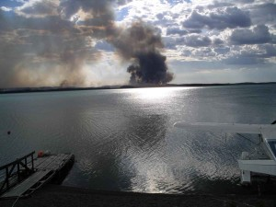
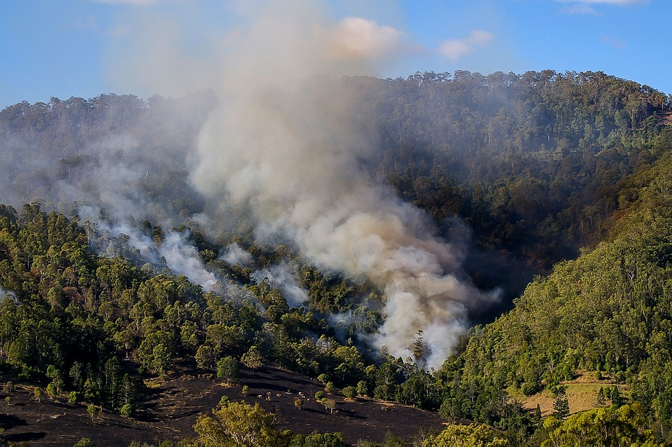

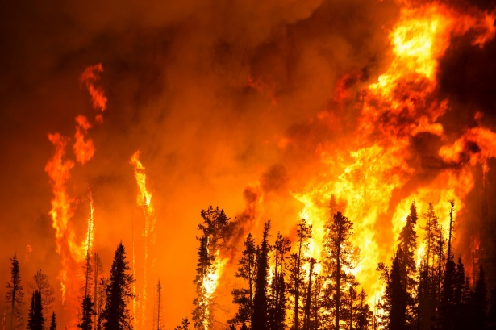
OUR SOURCES
More Data
Better for Neural Network
More accuracy

Slide 8
ANALYSIS
CNN Manipulation
More epoch
Larger images
Better accuracy ✅
Longer runtimes ❌
More epoch
Larger images
Size: 32px
Runtime: 15.83s
Epoch: 40
Final Accuracy: 81%
Size: 64px
Runtime: 18.25s
Epoch: 20
Final accuracy: 50%

Slide 9
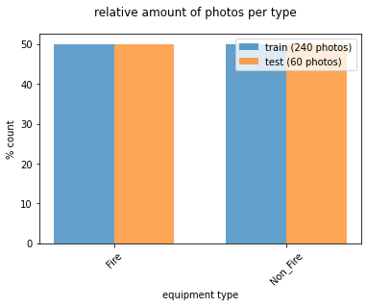
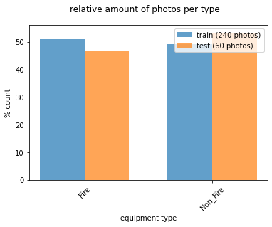
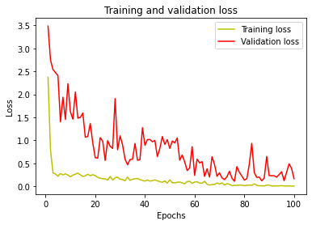
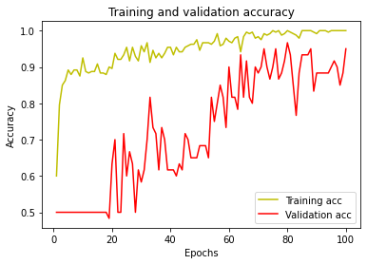
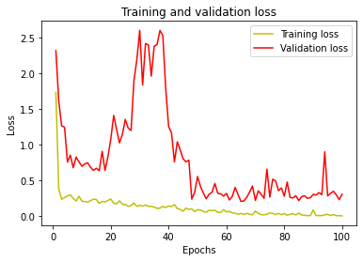
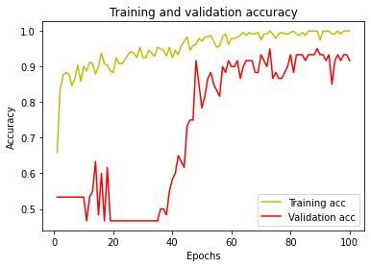
ANALYSIS
Stratification
Stratified
Unstratified
2 seconds difference
2% difference
IT DOESN’T MATTER!
Notes:
177 seconds against 179 seconds
93% vs 95%

Slide 10
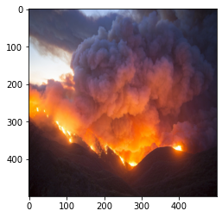

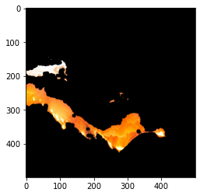
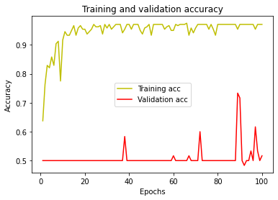
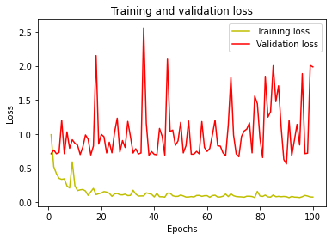
ANALYSIS
Masking
An alternative to feature selection?
Original
Sharpen
Masking + Segmentation
Very poor results: ~50%
Time gained: 1 second (~1.5%)

Slide 11


ANALYSIS
Training/Test Split Ratio
Ratio | 0.1 | 0.2 | 0.3 | 0.4 | 0.5 | 0.6 | 0.7 | 0.8 | 0.9
Accuracy (%) | 90 | 82 | 77 | 79 | 79 | 54 | 58 | 50 | 50
Time (s) | 97 | 89 | 83 | 83 | 76 | 67 | 60 | 52 | 45
Optimal ratio
Accuracy
Time
Proportion
Notes:
177 seconds against 179 seconds
91% vs 95%

Slide 12
FOLLOWING MODEL
Comparison
Model | Random Forest | Decision Tree | Gradient Boosting | ADA Boosting | MLP
Accuracy (%) | 90 | 86 | 90 | 93 | 93
Time (s) | 1.35 | 1.34 | 33.13 | 39.30 | 89.96
Optimal model
Notes:
177 seconds against 179 seconds
91% vs 95%

Slide 13
ANALYSIS
Optimisation
Number of images: 4402
Size of the images: 32
Number of epoch: 7
Test/Train split ratio: 20%
Stratification: ON
Masking: OFF
Following model: Random Forest

Slide 14
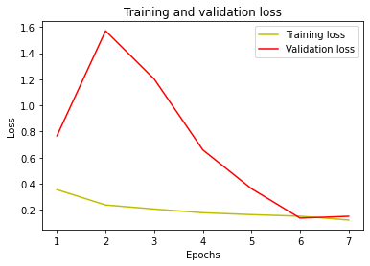
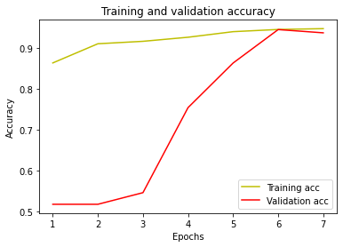
FINAL RESULTS
CNN Accuracy: 93%
Time: 30 seconds
Random Forest Accuracy: 95%
Time: 15 seconds
Notes:
NFPA Standard 1710 establishes an 80 second “turnout time” and 480 second “travel time” (together, 560 seconds or 9 minutes and 20 seconds “response time”) benchmark time goal for the deployment of “an initial full alarm assignment at a fire suppression incident” for not less than 90% of dispatched incidents.
Essaie de refaire pour avoir moins de non-fire qui sont actuellemtn des fires

Slide 15
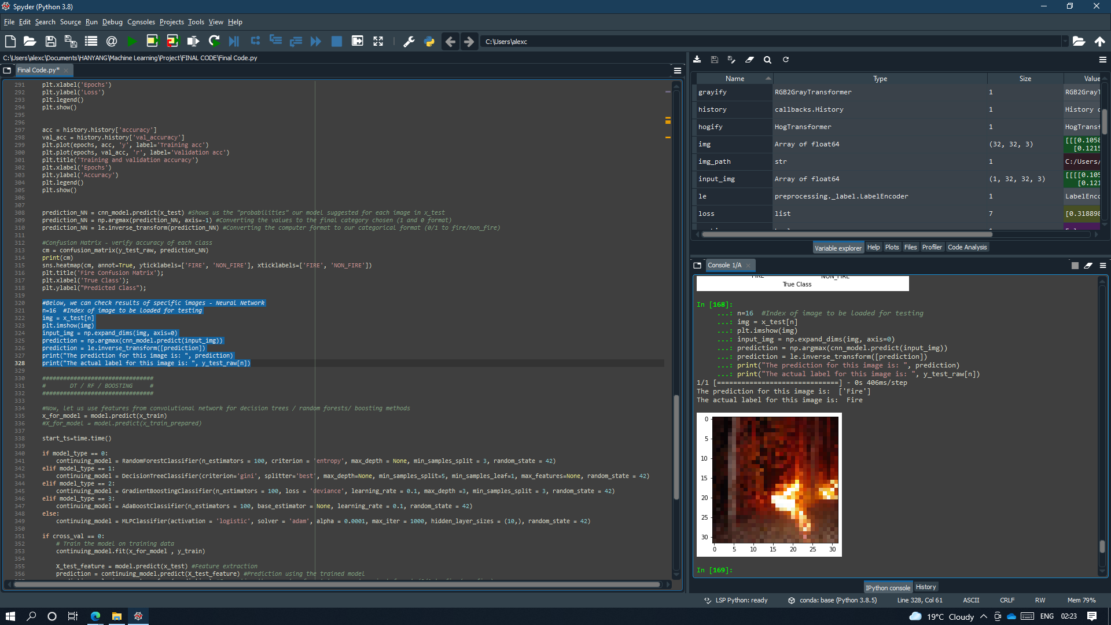
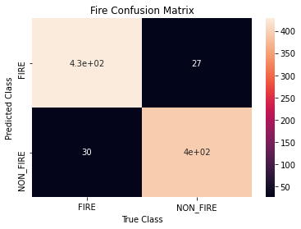
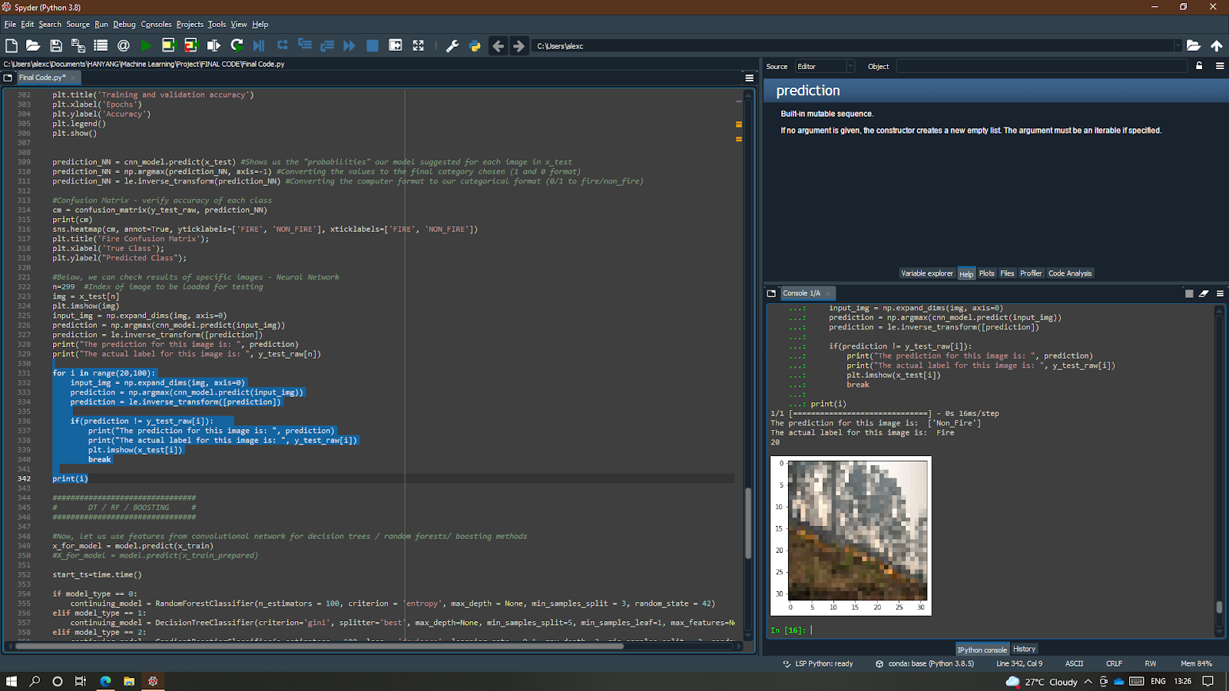
FINAL RESULTS
CNN Accuracy: 93%
Time: 30 seconds
428
Random Forest Accuracy: 95%
Time: 15 seconds
395
Notes:
NFPA Standard 1710 establishes an 80 second “turnout time” and 480 second “travel time” (together, 560 seconds or 9 minutes and 20 seconds “response time”) benchmark time goal for the deployment of “an initial full alarm assignment at a fire suppression incident” for not less than 90% of dispatched incidents.
Essaie de refaire pour avoir moins de non-fire qui sont actuellemtn des fires

Slide 16
FINAL RESULTS
A supportive system?
428
395
Can we solve this?
Notes:
NFPA Standard 1710 establishes an 80 second “turnout time” and 480 second “travel time” (together, 560 seconds or 9 minutes and 20 seconds “response time”) benchmark time goal for the deployment of “an initial full alarm assignment at a fire suppression incident” for not less than 90% of dispatched incidents.
Essaie de refaire pour avoir moins de non-fire qui sont actuellemtn des fires

Slide 17
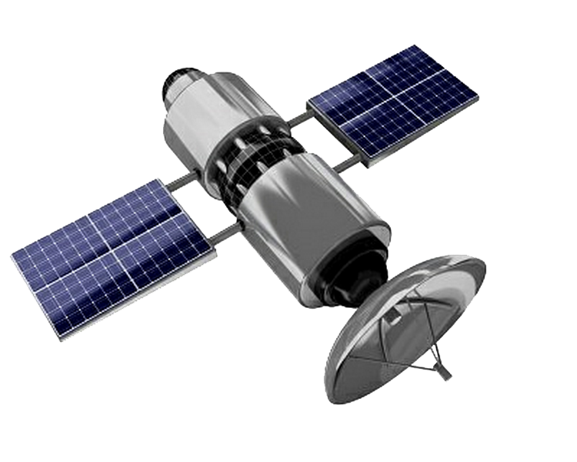
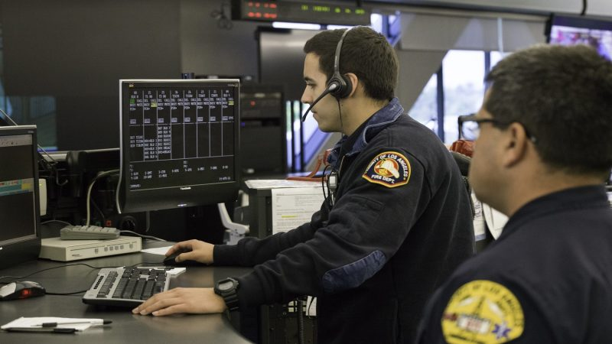
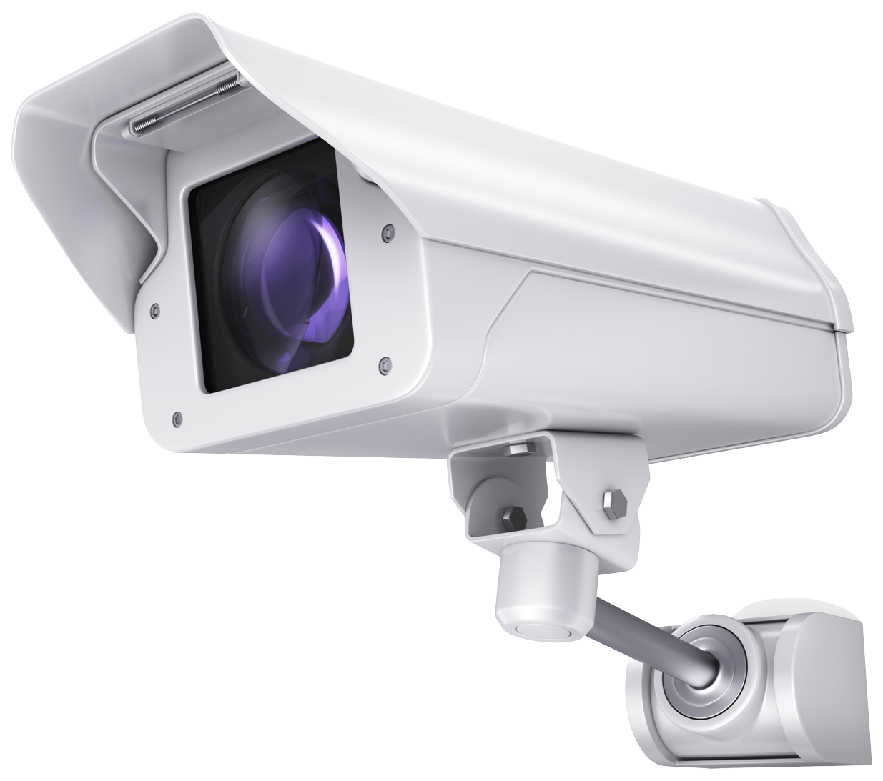
IMPLEMENTATION
HOW?
Satellite
CCTV
Firefighter evaluation system

Slide 18
COST
Budget estimation
Software
Firefighter system (175K $)
Maintenance (35K $ / year)
Imagery Investment
CCTV - 200$ / camera
Satellite - Rent (1.75 M$ / year)
Satellite - Launch (3 x 120M $)
Hardware
Servers (10K $)
Maintenance (5K $ / year)
TOTAL: 2,185,000$
(+ 40,000$ / year)
With 1000 cameras
Notes:
What's the cheapest launch price for a small geosynchronous satellite? - Quora
Three Geo synchronous satellites are required to cover the entire geographical area that are placed at 120 degree (120*3=360)
15 to 20 percent of the original development costs
Based on our experience, the ballpark range of software development costs is between $50,000 to $250,000.
When counting insured losses, the 2020 wildfire season is estimated to have produced between $5 billion and $9 billion in destruction, and this comes after wildfire seasons in 2017 and 2018 that each produced more than $10 billion in insured losses.
Wildfires across California in 2018 produced $7.8 billion in estimated health costs

Slide 19
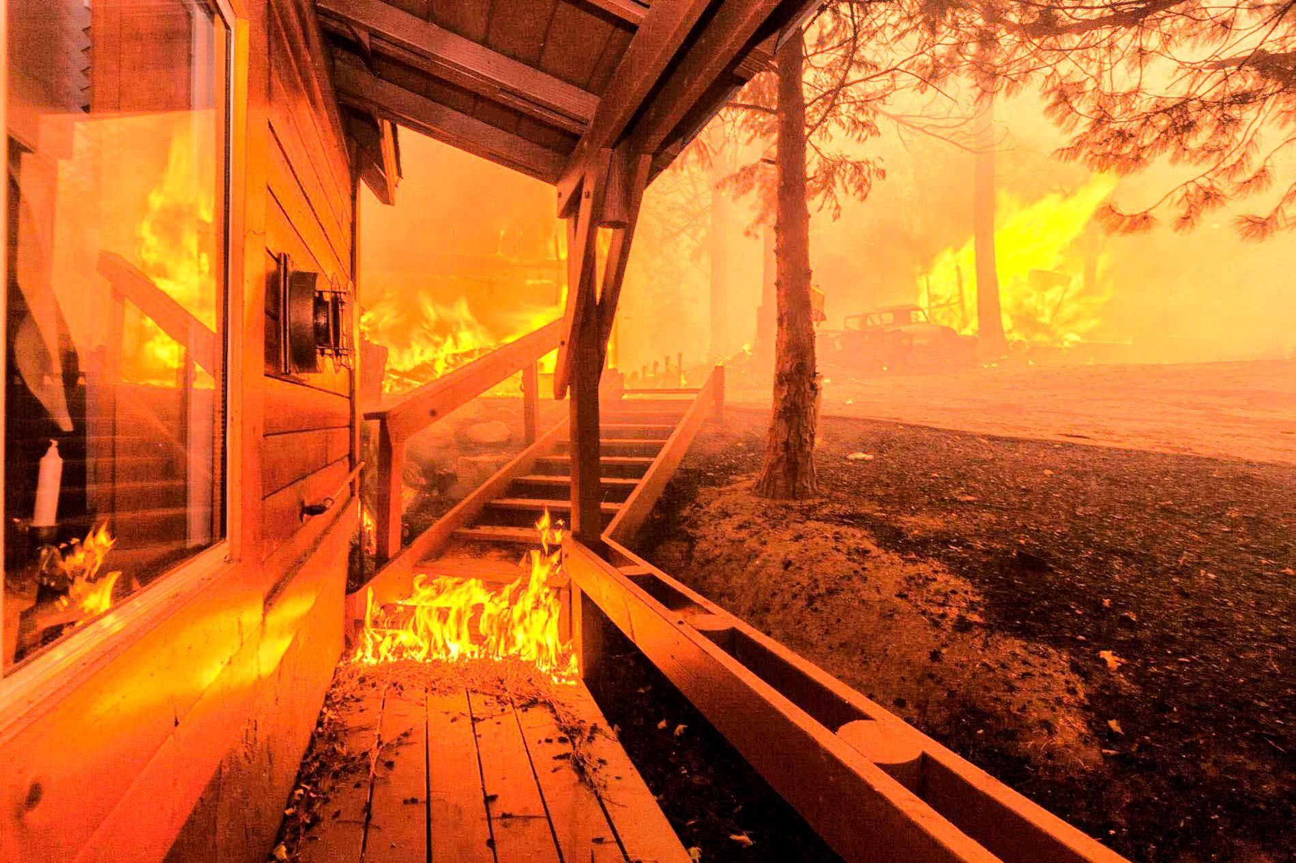
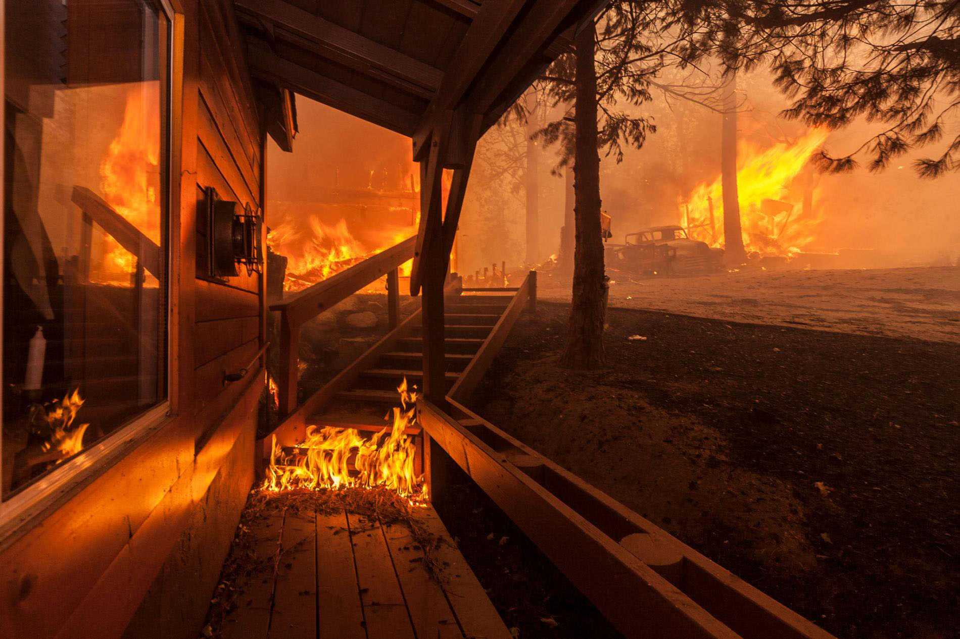
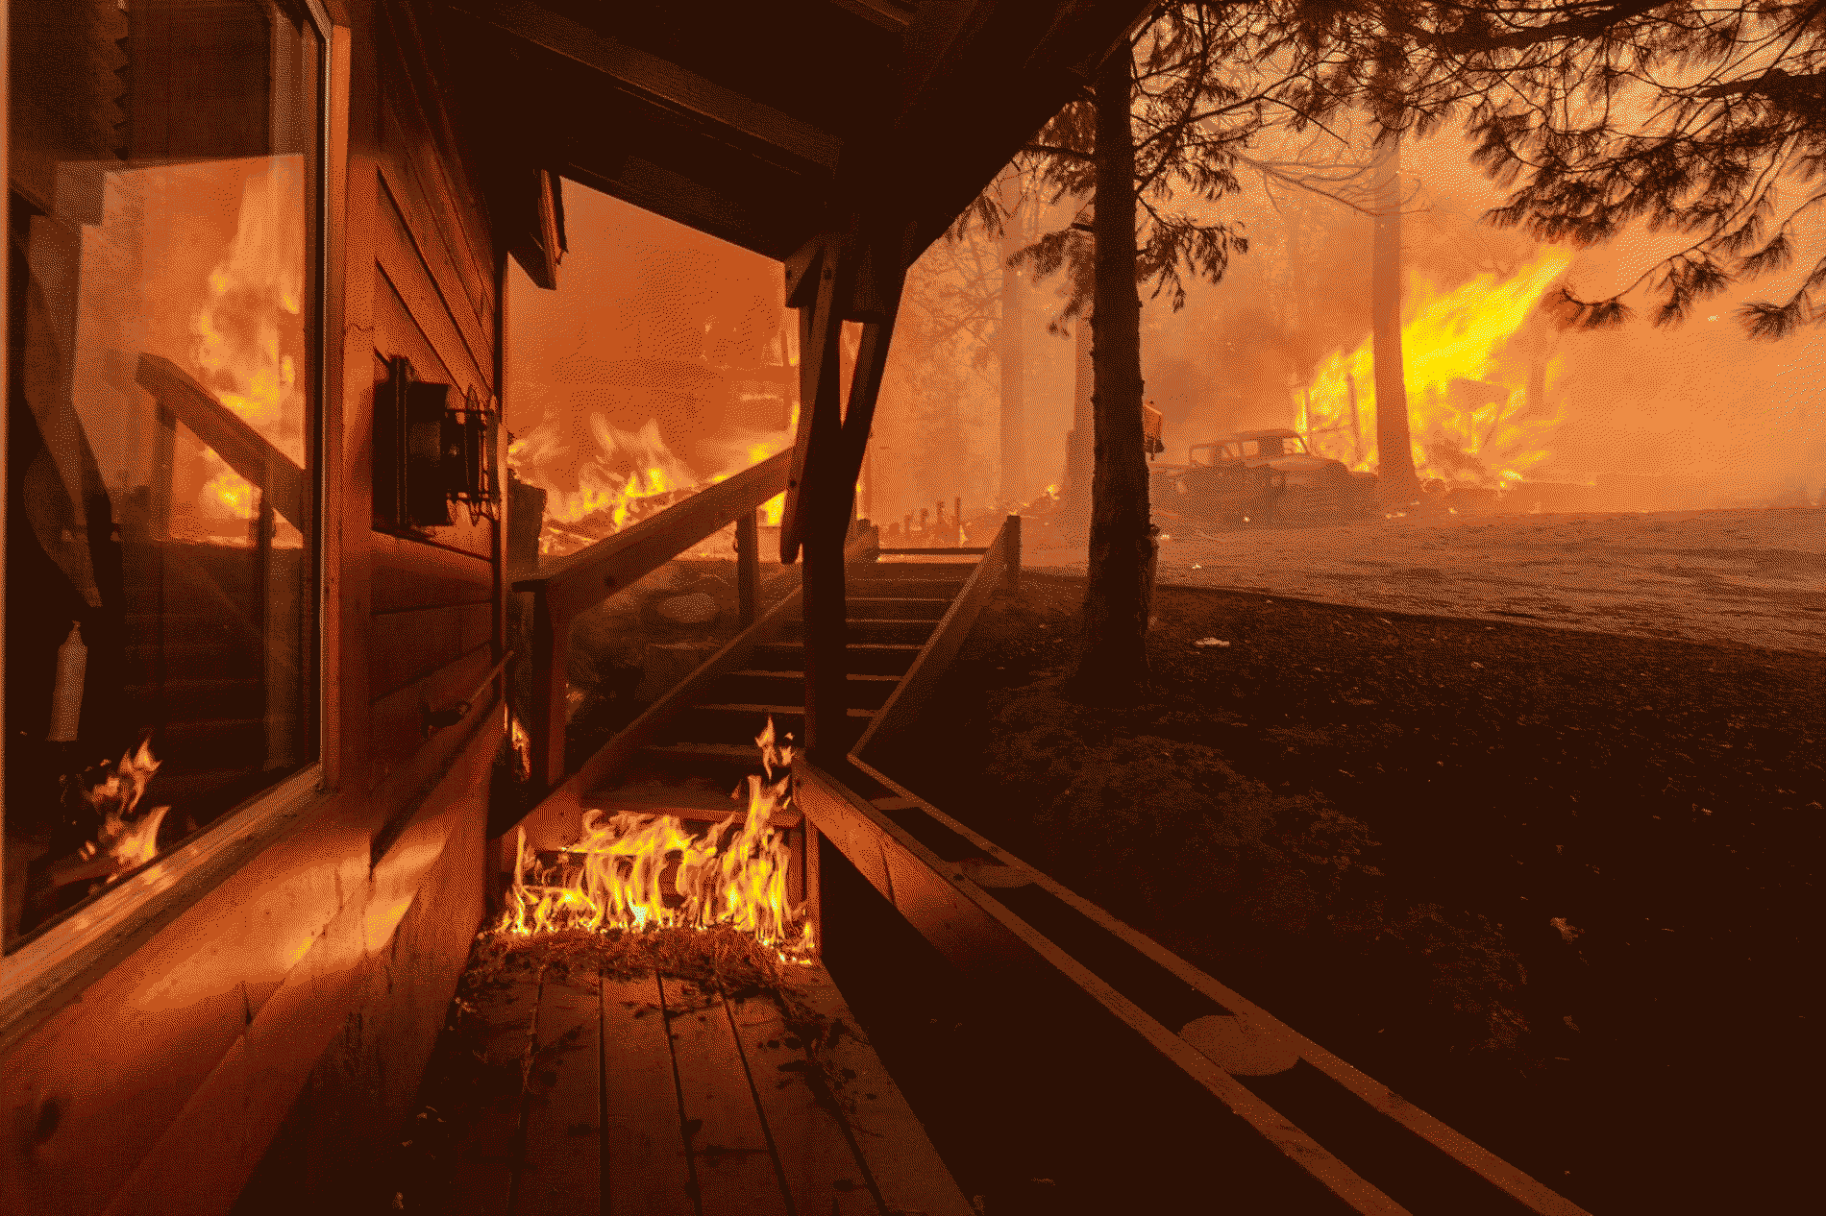
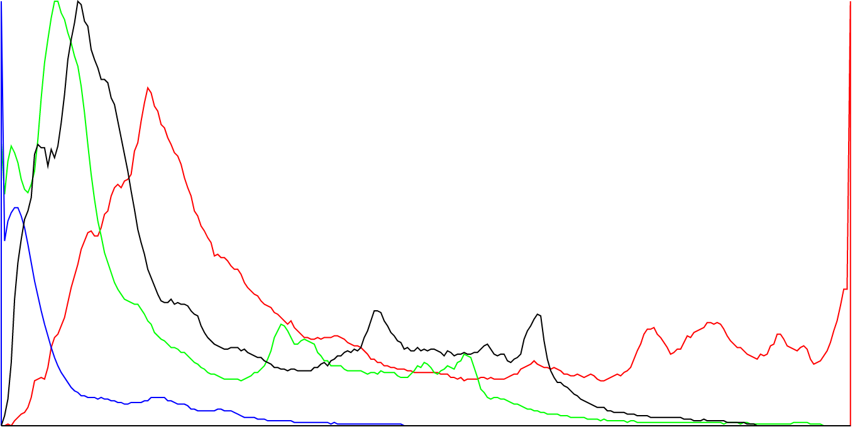
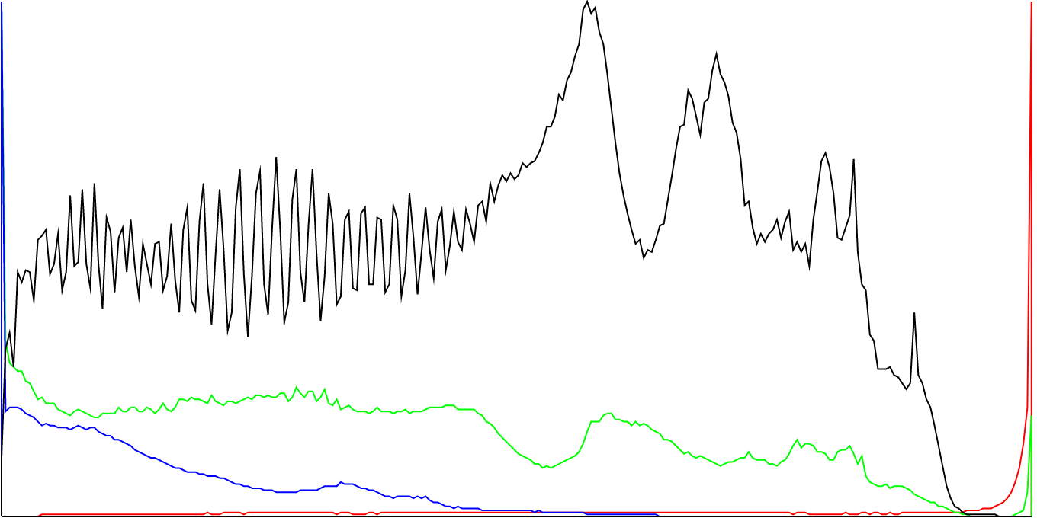
IMPROVEMENTS
Dominant Colour
Colour Palette
Equalisation
Before
After
Quantization
Notes:
What's the cheapest launch price for a small geosynchronous satellite? - Quora
Three Geo synchronous satellites are required to cover the entire geographical area that are placed at 120 degree (120*3=360)
15 to 20 percent of the original development costs
Based on our experience, the ballpark range of software development costs is between $50,000 to $250,000.

Slide 20
IMPROVEMENTS
Dominant Colour
Colour Palette
Equalisation
Before
After
Quantization
Notes:
What's the cheapest launch price for a small geosynchronous satellite? - Quora
Three Geo synchronous satellites are required to cover the entire geographical area that are placed at 120 degree (120*3=360)
15 to 20 percent of the original development costs
Based on our experience, the ballpark range of software development costs is between $50,000 to $250,000.

Slide 21
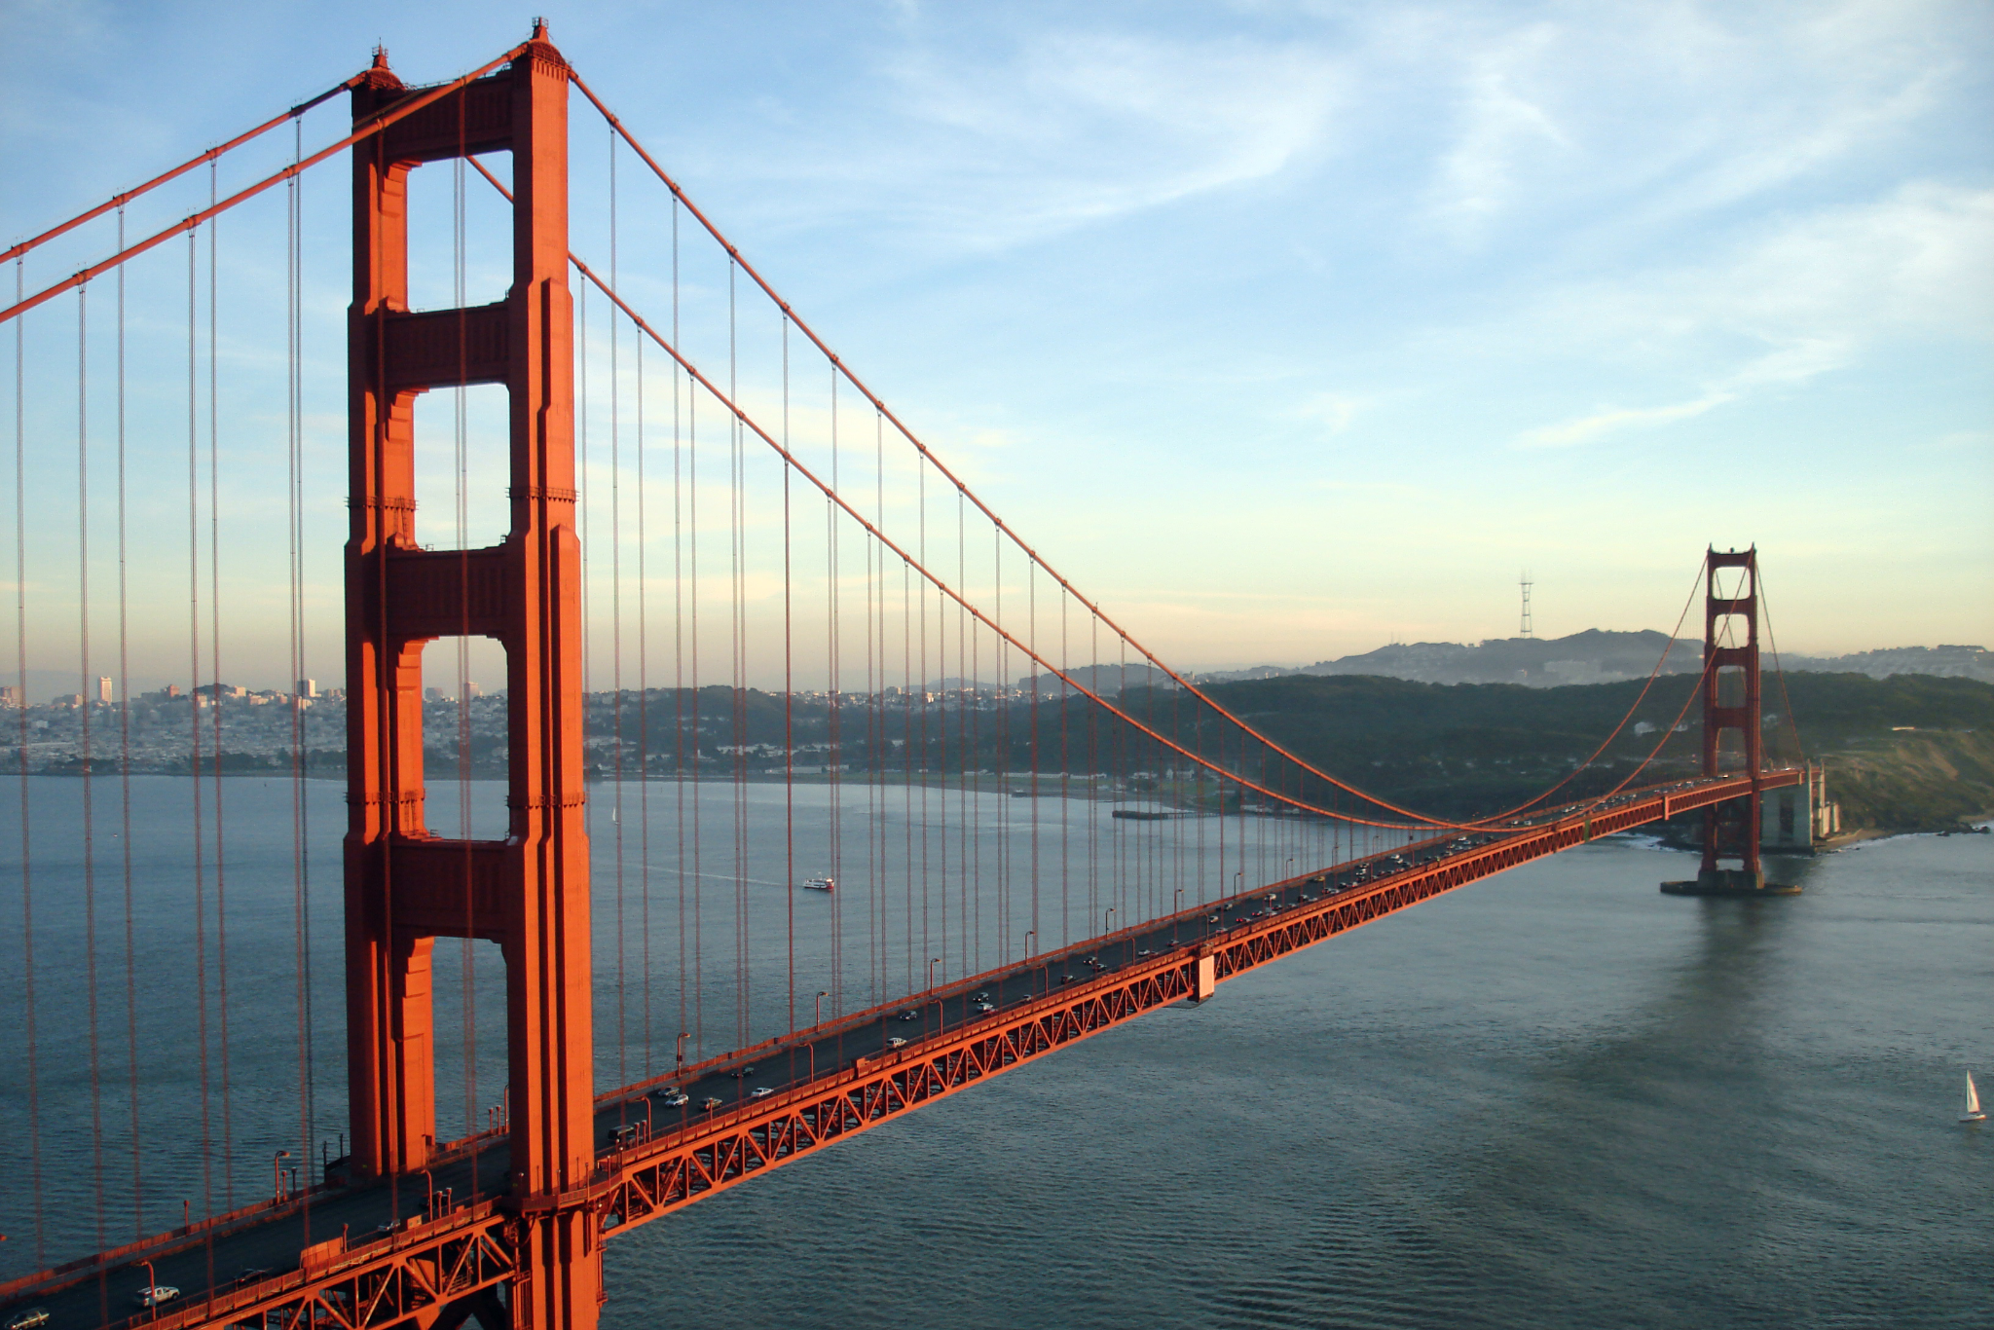
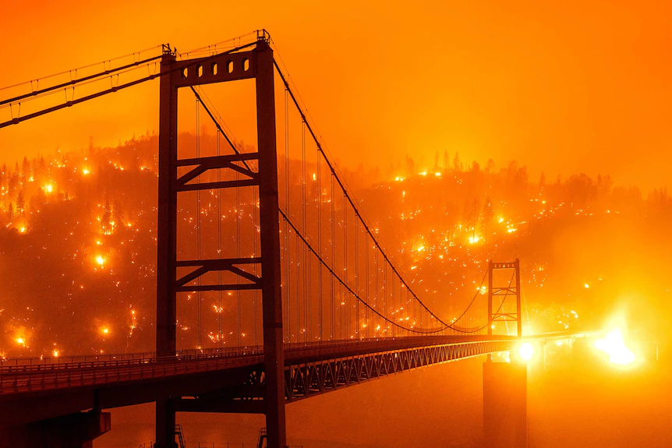


THANK YOU!

